Slide 1
AI-Based Medical Representative
Project Review III
Visit prioritization and route optimization
A predictive, constraint-based planner that turns daily doctor-visit planning from guesswork into a data-driven decision.
Bhakti Jayantilal Gundecha · 3071
Parth Lokhande · 1020
Udaykiran Bitla · 3056
Group 19
Guide: Prof. M. U. Buchade
PVG's College of Engineering, Technology & Management, Pune
Department of AI & Data Science

Slide 2
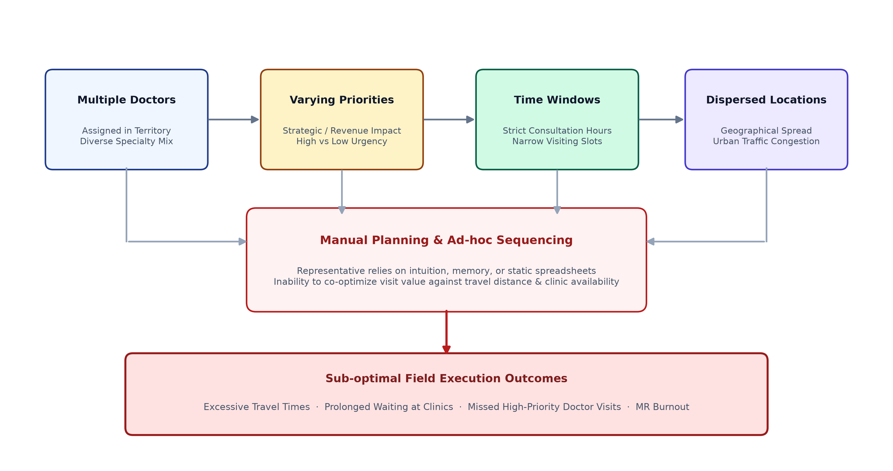
Problem statement
Introduction
Medical Representatives need to visit multiple doctors during a working day. Manual planning becomes difficult when the number of doctors increases and each doctor has different:
Priority
Availability
Preferred visit time
Visit duration
Location
Follow-up requirement
Travel time
Working-hour constraints
Multiple doctors
Different priorities
Different time windows
Different locations
Limited MR working hours
Manual planning
→
→
→
→
→
Group 19 · Project Review III · 2

Slide 3
Abstract
Introduction
Medical Representatives (MRs) are required to plan multiple doctor visits within limited working hours, where doctor priority, availability, visit duration, geographical distance and travel time make manual planning difficult. This project proposes an AI-based web application for visit prioritization and route optimization.
The system uses historical and operational data to estimate the priority of planned doctor visits using a Machine Learning model. The resulting priority information is combined with appointment time windows, visit duration, MR working hours and travel information. Google OR-Tools is then used to generate a feasible route using Vehicle Routing Problem with Time Windows (VRPTW) concepts.
The system provides role-based dashboards for Medical Representatives and managers, enabling data-driven visit planning, monitoring and analysis.
Keywords: Medical Representative, Machine Learning, Visit Prioritization, Route Optimization, VRPTW, Random Forest, Google OR-Tools
Group 19 · Project Review III · 3

Slide 4
Why this project?
Introduction
Medical Representatives spend significant time in field activities.
Doctor selection
Appointment scheduling
Travel planning
Visit execution
Follow-up
→
→
→
→
The existing manual process creates three major challenges:
1
2
3
Prioritization problem
Scheduling problem
Routing problem
Which doctor should be visited first?
When can the doctor be visited?
In what sequence should doctors be visited?
Visit priority → Machine Learning → “Who to prioritize?”
Route sequence → Optimization → “Where and when to go?”
Group 19 · Project Review III · 4

Slide 5
Existing system
Introduction
Manager / MR
Select doctors
Check availability
Manually arrange visits
Estimate travel
Prepare daily schedule
Visit doctors
→
→
→
→
→
→
Existing approach | Limitation
Manual prioritization | Subjective
Spreadsheet planning | Difficult to scale
Map navigation | Navigation ≠ visit scheduling
Separate appointment system | Doesn't optimize the entire route
Static plans | Difficult to handle changes
Limited analytics | Poor management visibility
Group 19 · Project Review III · 5

Slide 6
Literature survey
Background
Study | Main focus | Technique | Limitation / gap
Yi et al. | Physician detailing planning | Neural network + optimization | Older expert-system approach
Zhang et al. | Pharmaceutical sales representative routing | Orienteering + time windows | Focuses strongly on routing/selection
Solomon | VRPTW | Routing algorithms | General routing benchmark
Liu et al. | VRPTW literature review | Survey | No MR-specific application
Rhee & Yi | Physician interest prediction | Predictive modelling | Targeting rather than route planning
Bouatouche & Belkadi | Sales representative planning | Hybrid optimization | Optimization-focused
Shala et al. | Field-service planning | Operations research | Technician/service context
Group 19 · Project Review III · 6

Slide 7
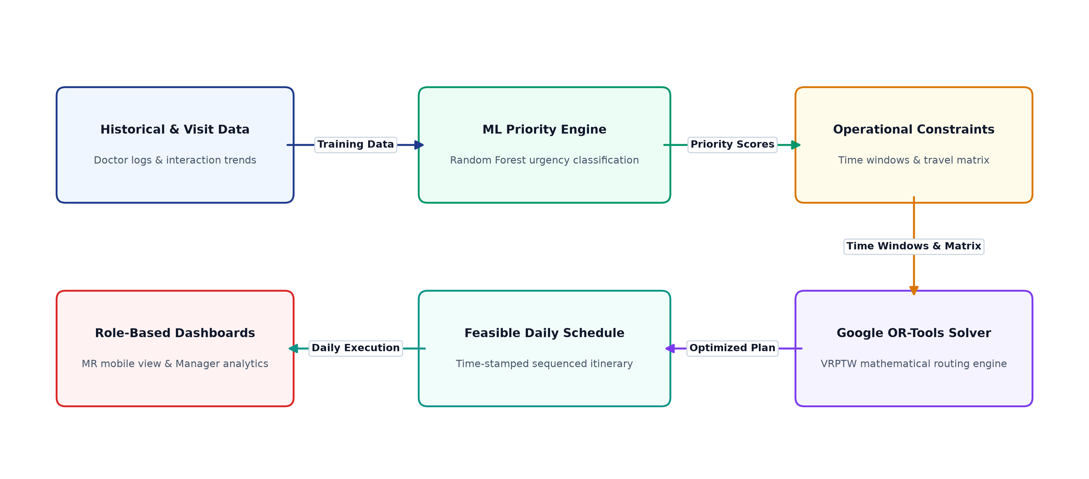
Research gap
Background
Existing research commonly addresses physician targeting, sales representative planning, appointment scheduling, vehicle routing and field-service optimization. However, these areas are often treated as separate decision problems.
Historical / operational data
Visit prioritization (ML model)
Priority information
Appointment constraints + travel information
Route optimization (OR-Tools)
Daily visit schedule
→
→
→
→
→
Research contribution: integration of data-driven visit prioritization with constraint-based route optimization in a single MR decision-support workflow.
Group 19 · Project Review III · 7

Slide 8
Three intelligence layers
Proposed solution
Layer 1 · Prediction
Layer 2 · Optimization
Layer 3 · Application
Machine learning
Google OR-Tools / VRPTW
Web dashboard
Predict visit priority.
“Which planned visit is more important?”
Generate a feasible route.
“In what sequence should visits be performed?”
Allow MRs and managers to interact with the results.
Agency data
Data preprocessing
Priority prediction + constraints
Route optimization (OR-Tools)
Optimized schedule
MR dashboard | Manager dashboard
→
→
→
→
→
Group 19 · Project Review III · 8

Slide 9
Proposed methodology
Proposed solution
Phase 1
Phase 2
Phase 3
Data collection
Data preprocessing
Machine learning
Doctor, MR, historical visit, appointment, location and visit-outcome information; existing priority/category information, if available.
Remove duplicates, handle missing values, validate coordinates, encode categorical features, normalize/transform where required, detect inconsistent records.
Train priority prediction model.
Phase 4
Phase 5
Phase 6
Optimization
Web application
Evaluation
Create travel-time matrix, distance matrix, time windows, visit duration and working-hour constraints. Then solve the routing problem.
FastAPI + React + MySQL.
Compare manual/baseline plan vs optimized plan.
Group 19 · Project Review III · 9

Slide 10
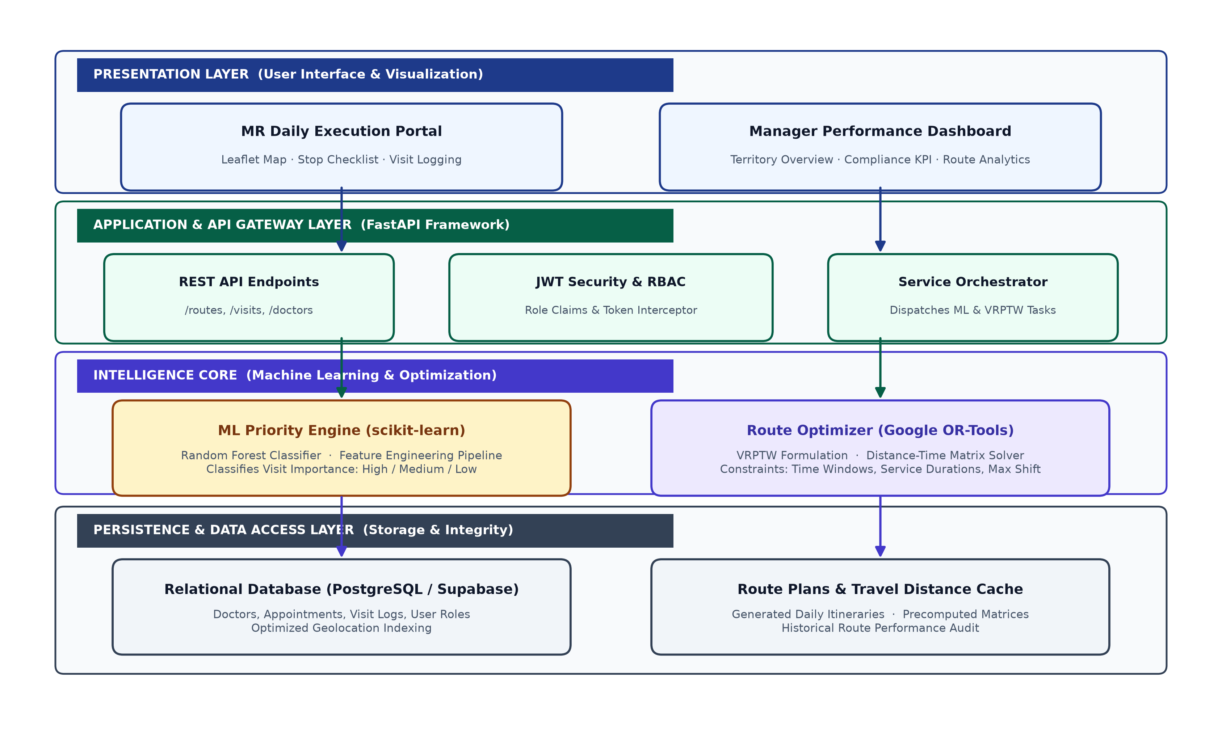
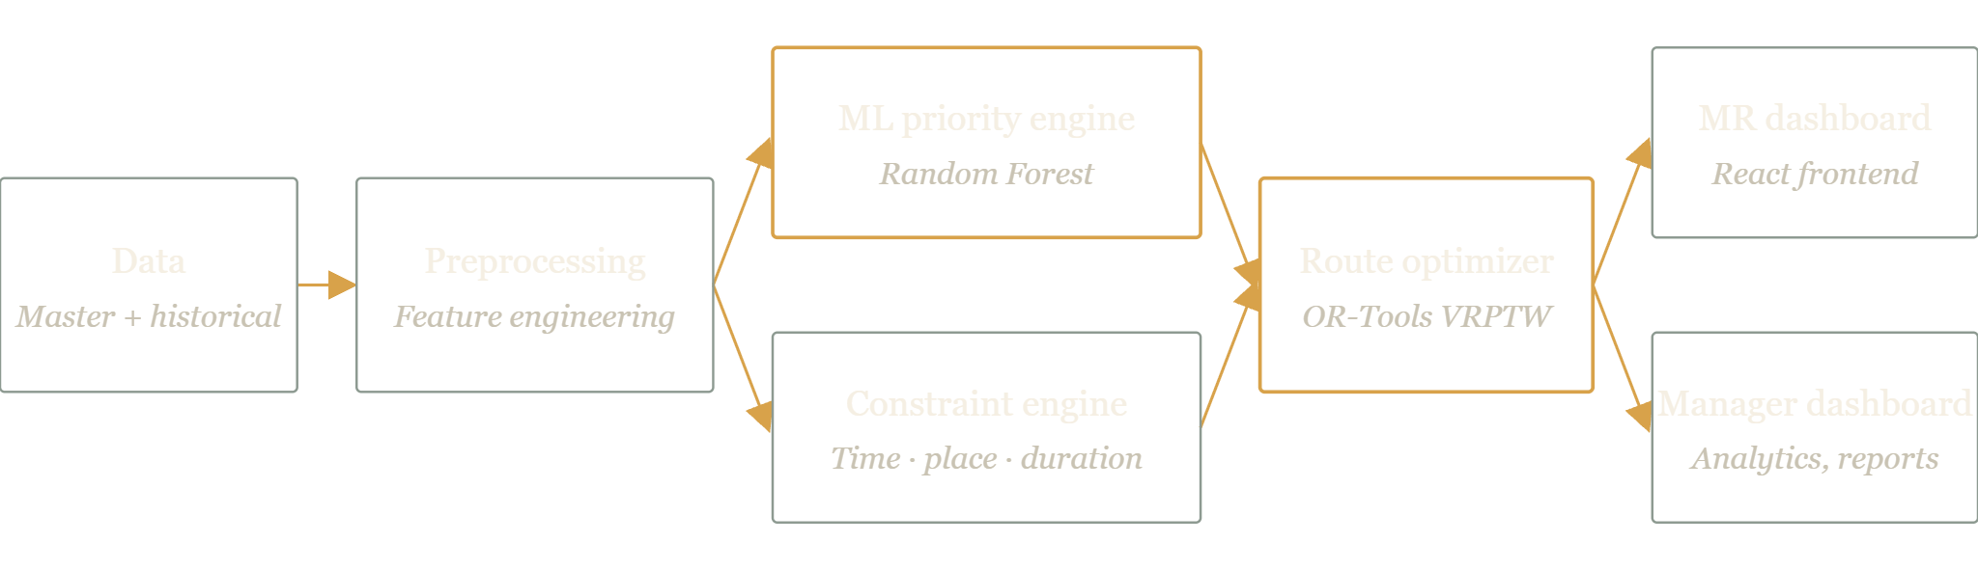
System architecture
Design
Group 19 · Project Review III · 10

Slide 11
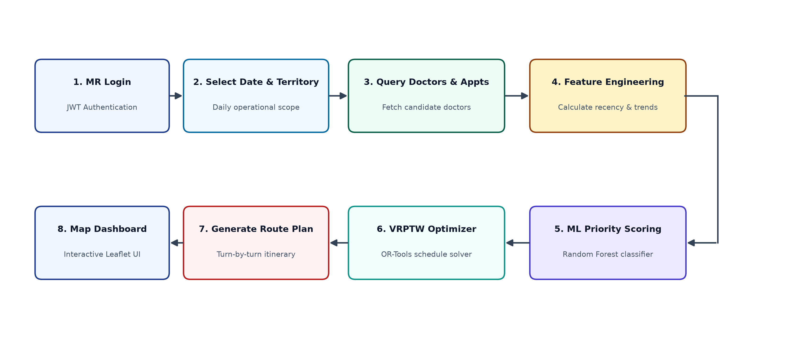
Data flow
Design
Suppose an MR logs in.
MR login
Select date
Retrieve assigned doctors
Retrieve appointment constraints
ML priority prediction
→
→
→
→
Generate priority information
Retrieve travel matrix
Apply constraints
OR-Tools optimization
Generate route
→
→
→
→
Display: doctor · visit order · time · priority · travel time · distance
Group 19 · Project Review III · 11

Slide 12
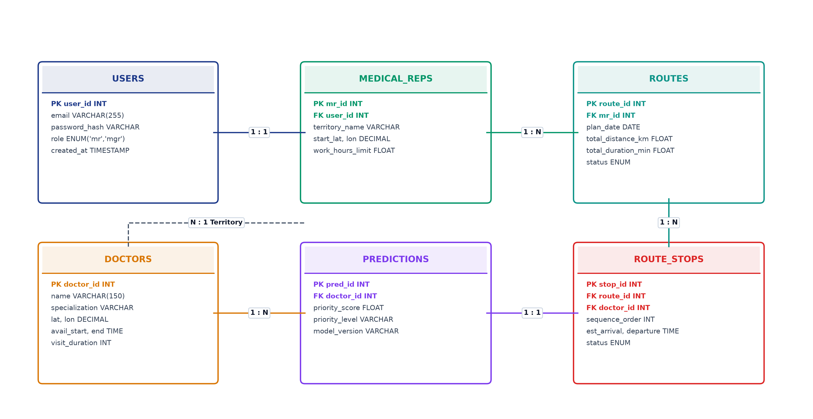
Data design
Design
Doctor
Medical Representative
doctor_id, specialization, territory, latitude, longitude, availability_start, availability_end, typical_visit_duration, priority_category
mr_id, territory, working_start, working_end, start_location, end_location
Visit
Appointment
visit_id, doctor_id, mr_id, visit_date, planned_time, actual_arrival, actual_departure, visit_status, visit_outcome, follow_up_required
appointment_id, doctor_id, mr_id, appointment_date, window_start, window_end, duration, status
Group 19 · Project Review III · 12

Slide 13
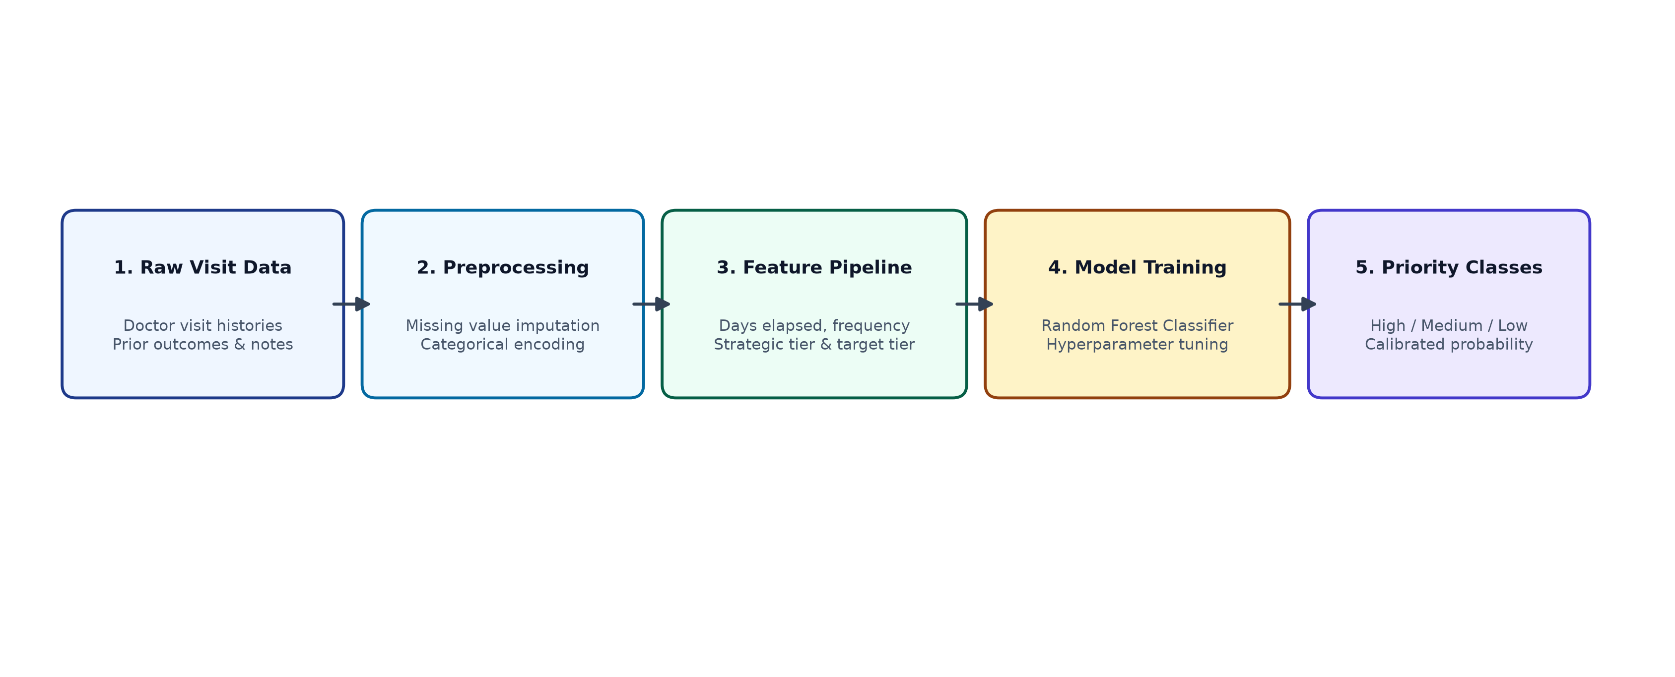
ML priority prediction
Machine learning
The model does not generate the route. It predicts the importance/priority of a planned doctor visit.
Historical visit frequency
Days since last visit
Previous visit outcome
Follow-up requirement
Existing priority category
Appointment status
Doctor engagement indicator
Visit history
Territory information
Other approved operational features
Historical data
Feature engineering
Train/test split
Random Forest classifier
Predicted priority:
High / Medium / Low
→
→
→
→
The final ML formulation, classification or regression, will depend on the structure and reliability of the agency’s priority label.
Group 19 · Project Review III · 13

Slide 14
Feature engineering by example
Machine learning
Doctor A
Doctor B
Last visit: 25 days ago
Frequent follow-up
High historical priority
Appointment confirmed
Previous outcome requires follow-up
Recently visited
No follow-up
Low historical priority
Flexible availability
May receive a lower priority.
The model may assign a high priority probability.
These values are illustrative until the actual model is trained and evaluated.
Group 19 · Project Review III · 14

Slide 15
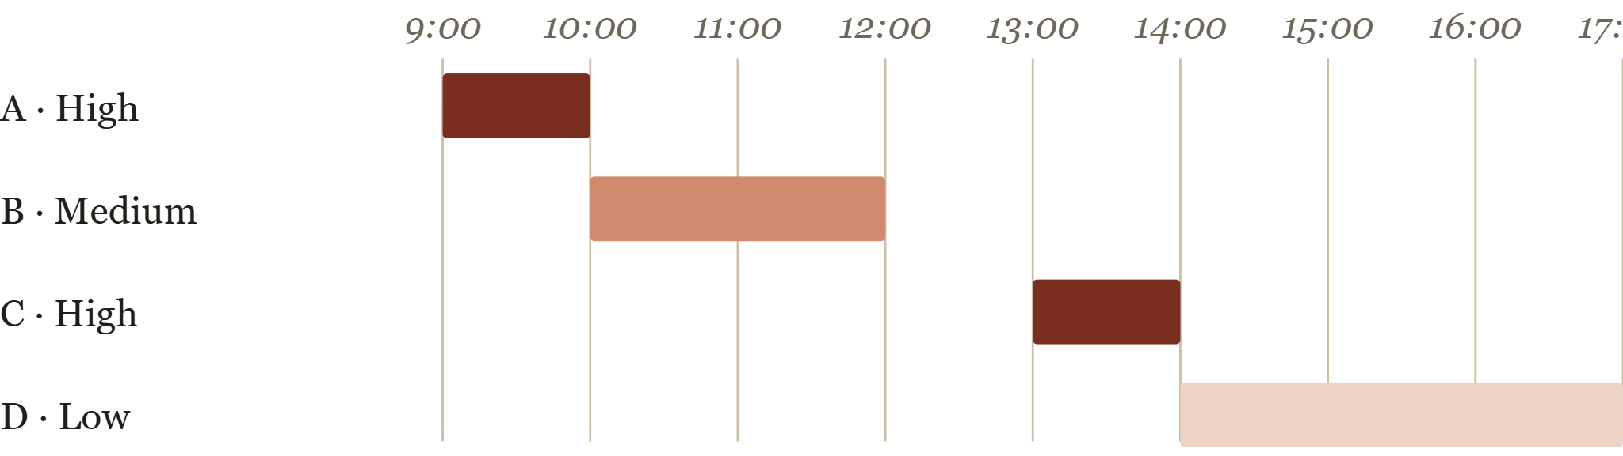
Route optimization
Optimization
Vehicle Routing Problem with Time Windows (VRPTW). Locations: MR start, Doctors A–D, MR end.
MR working hours
Doctor availability
Visit duration, travel time
Location
Appointment time window
Number of available MRs
Locations
Routing / travel-time source
Distance-time matrix
OR-Tools
Optimized route
→
→
→
→
Route must be feasible, priority-aware, time-window compliant and efficient. OR-Tools needs a distance/time matrix: a map/routing API, organization-provided data, precomputed distances or a controlled simulation.
Group 19 · Project Review III · 15

Slide 16
Optimization objective
Optimization
Minimize
Travel time + Waiting time + Penalty for missing important visits
Subject to
Priority information can influence which visits are more valuable to serve.
Doctor availability
MR working hours
Visit duration
Route feasibility
This is a simplified conceptual objective.
Group 19 · Project Review III · 16

Slide 17
Algorithms and techniques used
Implementation
Component | Technique
Data preprocessing | Cleaning + transformation
Priority prediction | Random Forest
Feature engineering | Statistical / domain features
Routing | Vehicle Routing Problem
Time constraints | VRPTW
Optimization engine | Google OR-Tools
Component | Technique
Backend | FastAPI
Database | MySQL
Frontend | React.js
Visualization | Charts + maps
API communication | REST APIs
Group 19 · Project Review III · 17

Slide 18
Module split-up
Implementation
Module 1
Module 2
Module 3
Module 4
Authentication & role management
Doctor management
MR management
Visit & appointment management
Doctor master, location, specialization, availability, visit duration
MR profile, territory, working hours, start/end location
Login, MR role, Manager role, access control
Create visit, appointment, reschedule, visit status, follow-up
Module 5
Module 6
Module 7
Module 8
ML priority engine
Route optimization
MR dashboard
Manager dashboard
Data preprocessing, feature extraction, model prediction, priority output
Travel matrix, constraints, OR-Tools, optimized sequence
Today's visits, priority, route, schedule, status
MR performance, planned/completed visits, priority visits, route analytics, reports
Group 19 · Project Review III · 18

Slide 19
Proposed system UI
Implementation
Login
MR dashboard
Manager dashboard
Email / username and password, then Login.
Total visits, completed, pending
High-priority visits
Today's route
Map
Total MRs, total planned visits
Completion rate
High-priority visits
MR-wise performance
Route efficiency
Group 19 · Project Review III · 19

Slide 20
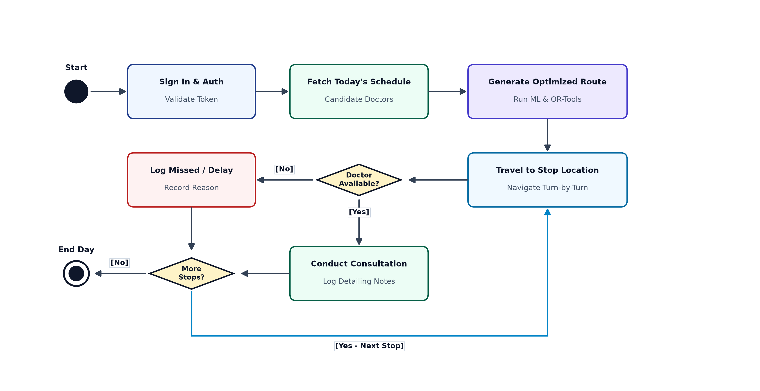
Working module: MR
Working modules
MR logs in
Dashboard shows today's visits
System retrieves doctor/appointment data
ML model generates priority
→
→
→
MR clicks Generate Optimized Route
OR-Tools processes
System produces route
→
→
Doctor | Priority
Doctor A | High
Doctor B | High
Doctor C | Medium
Doctor D | Low
Priority + location + time windows + visit duration + MR working hours
Route: 1 → Doctor A, 2 → Doctor B, 3 → Doctor C, 4 → Doctor D, with appointment times.
Group 19 · Project Review III · 20

Slide 21
Working module: manager
Working modules
12
82
61
21
19
XX%
Total MRs
Today's planned
Completed
Pending
High priority
Completion rate
The manager can see
MR-wise activity
Doctor visit status
High-priority visits
Completed / pending visits
Route information
Reports
Group 19 · Project Review III · 21

Slide 22
Complete working flow
Working modules
Login
→
Select date / territory
→
Fetch doctors
→
Fetch appointment data
Data cleaning
→
ML priority model
→
Constraints engine
→
OR-Tools
Optimized route
→
MR dashboard
→
Manager dashboard
Group 19 · Project Review III · 22

Slide 23
Technology stack
Implementation
Layer | Technology | Used for
Frontend | React.js | Dashboards, forms, tables, route visualization, user interaction
Backend | FastAPI / Python | APIs, authentication, ML inference, route optimization, database communication
Machine learning | Python + scikit-learn | Random Forest, preprocessing, evaluation
Optimization | Google OR-Tools | VRP, VRPTW, route constraints
Database | MySQL | -
Maps / travel information | Mapping/routing service, or approved/precomputed travel matrix | -
Group 19 · Project Review III · 23

Slide 24
Database design
Implementation
User
MR / Manager
Visit ↔ Doctor
Appointment
Priority prediction
→
Optimized route
→
→
→
→
Entity | Relates to
MR | visits, appointments, routes
Doctor | visits, appointments, location
Visit | priority_prediction
Route | route_stops
Group 19 · Project Review III · 24

Slide 25
Evaluation
Evaluation
ML evaluation
Route evaluation
Classification: accuracy, precision, recall, F1-score, confusion matrix, and ROC-AUC where appropriate. F1, precision and recall can be more informative than accuracy alone, depending on class balance.
Baseline (manual, nearest-neighbour or simple ordering) versus proposed (ML + OR-Tools).
Total distance, total travel time
Visits completed, unserved visits
Time-window violations
Waiting time
Route computation time
Group 19 · Project Review III · 25

Slide 26
Baseline comparison
Evaluation
Same input
Baseline plan | Proposed system
Metrics
Comparison
→
→
→
Metric | Baseline | Proposed | Improvement
Distance | X | Y | calculated
Travel time | X | Y | calculated
Visits completed | X | Y | calculated
Time-window violations | X | Y | calculated
The actual values will come after experiments.
Group 19 · Project Review III · 26

Slide 27
Challenges and solutions
Risks
Challenge | Proposed solution
Missing data | Data validation + imputation where justified
Incorrect coordinates | Coordinate validation
Insufficient ML labels | Alternative ranking / rule-based formulation
Data privacy | Anonymization + restricted access
Changing appointments | Route regeneration
Traffic variation | Estimated travel-time matrix first; dynamic API later
Challenge | Proposed solution
Model overfitting | Train/test split + cross-validation
Imbalanced priority classes | Class weighting / suitable sampling
No agency data | Approved public/synthetic data for prototype
Route infeasibility | Constraint validation + fallback handling
API failure | Cached/precomputed travel matrix
Multiple MRs | Multi-vehicle routing architecture
Group 19 · Project Review III · 27

Slide 28
Security and privacy
Risks
Security
Privacy
Role-based access
Password hashing
API authentication
Input validation
Restricted database access
Secure configuration/secrets
We do not require patient medical records for the core system.
Use Doctor ID → D001, MR ID → MR007 rather than unnecessary personally identifiable information.
Group 19 · Project Review III · 28

Slide 29
Limitations
Risks
1
Quality of ML predictions depends on available historical data.
4
The initial prototype may focus on a limited territory.
5
Commercial CRM integration may not be included in the academic prototype.
2
The initial system may use estimated travel times rather than live traffic.
6
Model performance must be validated using actual experimental data.
3
Dynamic changes may require route regeneration.
Group 19 · Project Review III · 29

Slide 30
Future scope
Outlook
Real-time GPS tracking
Live traffic integration
Dynamic route re-optimization
Mobile application
Multiple-city deployment
Multiple-MR optimization
CRM integration
Automatic appointment rescheduling
Advanced ranking models
Reinforcement-learning / advanced optimization research
Predictive analytics for field performance
Group 19 · Project Review III · 30

Slide 31
Current working status
Progress
Completed
In progress
Upcoming
Problem definition
Literature survey
System architecture
UI design
Database design
Backend structure
ML pipeline
OR-Tools optimization
Dashboard
Integration
Testing
Final deployment
Group 19 · Project Review III · 31

Slide 32
Semester-I partial report
Progress
Semester-I deliverables
Problem identification, topic finalization
Literature survey, requirement analysis
Dataset / data requirement analysis
System architecture, technology and algorithm selection
Database design, UI design, initial prototype
Semester-II focus
Implementation
→
ML training
→
Optimization
→
Integration
Testing
→
Evaluation
→
Deployment
→
Final demonstration
Group 19 · Project Review III · 32

